Slide 1
BUCS & LUSL Leagues and Knockouts
Committee Training
arts-su.com

Slide 2
What is BUCS?
BUCS stands for British Universities and Colleges Sport
Main provider of sporting competitions for Universities
Facilitates league and cup competitions
All fixtures take place on Wednesdays

Slide 3
UAL BUCS Teams
Men’s Basketball
Mixed Equestrian
Men’s Football
Women's Hockey
Women’s Netball 1 and 2
Men’s Rugby
Men's Volleyball
Women's Volleyball
Wxmen's Basketball
There is a total of 10 teams competing in BUCS this season!

Slide 4
What is LUSL?
LUSL stands for London Universities Sports Leagues
London based Universities only
Facilitates league and cup competitions
Different sports are scheduled on different days (Saturdays – Mondays)

Slide 5
UAL LUSL Teams
Women’s Netball - Mondays
Mixed Volleyball – Mondays
Men’s Football - Saturdays
Mixed Badminton - Sundays
Women’s Football - Sundays
There is a total of 5 teams competing in LUSL this season!

Slide 6
Fixture Administration
arts-su.com

Slide 7
Officials
Officials are organised by the SU for all home fixtures
We will be sourcing and paying officials through YesRef
You are able to source your own officials, but they must be registered on YesRef and be appointed to that fixture to be paid
You can download BUCS and LUSL Match Officials Requirements from the Sport Specific Resources page on the Committee Resources page on the SU website

Slide 8
Transport
You will predominantly use public transport (underground, overground, bus) to travel to fixtures. This will be arranged by your captain/s, but the SU will be there to advise the best route. These costs will be paid for by the individual and will not be reimbursed by the SU
A minibus/coach will be booked by the SU for away fixtures that are outside London and take over 2 hours to get to. This will be discussed between the SU and your captain/s prior to the fixture. These costs will be paid for by the SU from our travel budget

Slide 9
Team Sheets
Complete the BUCS or LUSL paper Team Sheet BEFORE your match if BUCS Play has crashed or you are having internet connection issues
Pack x2 blank paper Team Sheets for all fixtures
You can download the BUCS or LUSL Team Sheet document from the Sport Specific Resources page on the Committee Resources page on the SU website

Slide 10
Playing Under Protest
Complete the BUCS or LUSL Playing Under Protest form BEFORE the start of the match
Both captains must sign the sheet
Some examples of when you would complete a Playing Under Protest form include the opposition plays an ineligible player, referee does not turn up/does not hold the required qualification, pitch/court has not been booked for length of fixture etc
Pack x2 blank paper Playing Under Protest Forms for all fixtures
Send the Playing Under Protest form to Cecie by 10am the day after your match
You can download the Playing Under Protest form and the Team Sheet document from the Sport Specific Resources page on the Committee Resources page on the SU website

Slide 11
Walkovers
Avoid giving walkovers at all costs!!
BUCS Leagues
Minimum 48-hour notice (unless bad weather, ground conditions etc)
-3 points for each walkover conceded
Fine of £50 per walkover which comes out of your club budget
3 walkovers or more will incur a £250 fine + no promotion
BUCS Knockouts (cup)
£300-£500 fine for walkovers

Slide 12
BUCS Play
arts-su.com

Slide 13
What is BUCS Play?
BUCS Play is the hub for ALL domestic British university sport competitions – BUCS and LUSL
EVERY PLAYER who wishes to compete for a BUCS or LUSL team must create a BUCS Play account to be eligible to participate
Download the BUCS Play app or visit the desktop version (PC only)
13
Notes:
Speaker: Ny

Slide 14
How to become a Captain on BUCS Play
Join your Sport Community
Wait for your Institution Administrator (IA) to grant you Captain access
You will receive an email once you have Captain access
Your Institution Administrator (IA; Cecie) will not be able to set you up as a Captain until you have joined your Sport Community!
14
Notes:
Speaker: Ny

Slide 15
Captain's responsibilities to be completed NOW!
1. Join your Sport Community 2. Join your Team
15
Notes:
Speaker: Ny

Slide 16
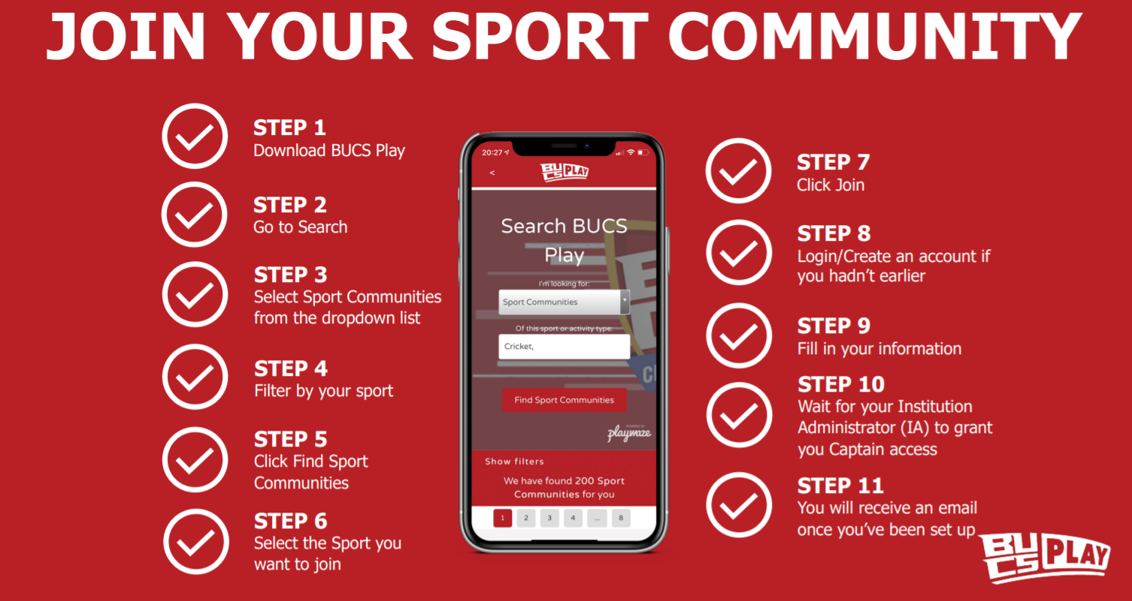

Slide 17
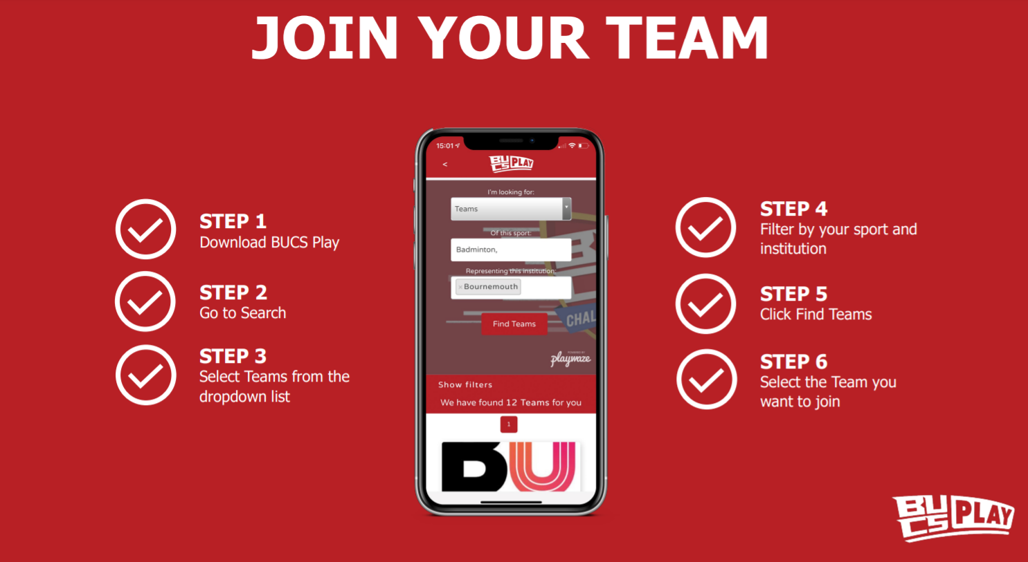
Notes:
Everyone must join your team – including the captain!

Slide 18
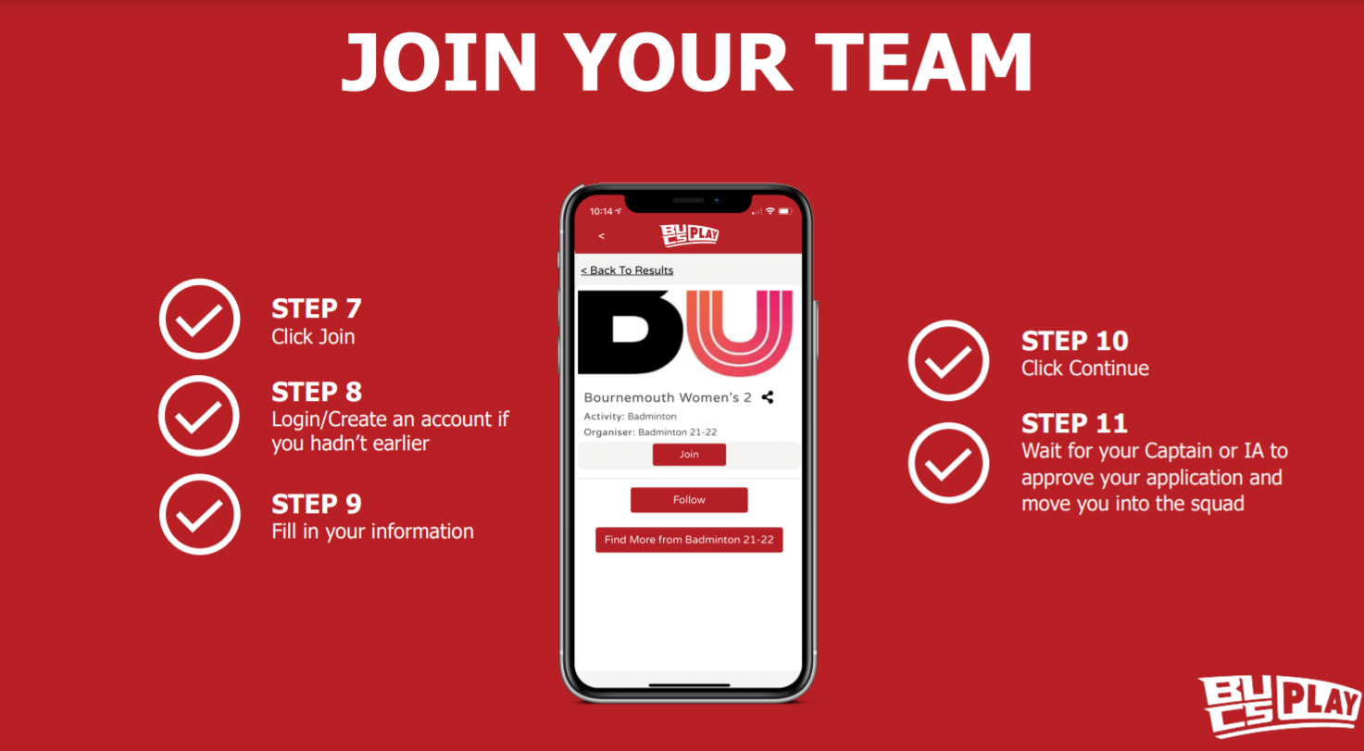

Slide 19
Captain's responsibilities to be completed PRIOR TO ALL FIXTURES!
1. Manage your squad
2. Select your team sheet
3. Approve or dispute the oppositions team sheet
19
Notes:
Speaker: Ny

Slide 20
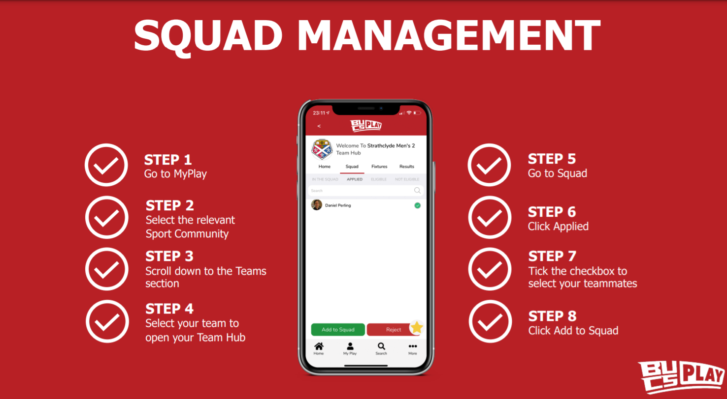

Slide 21
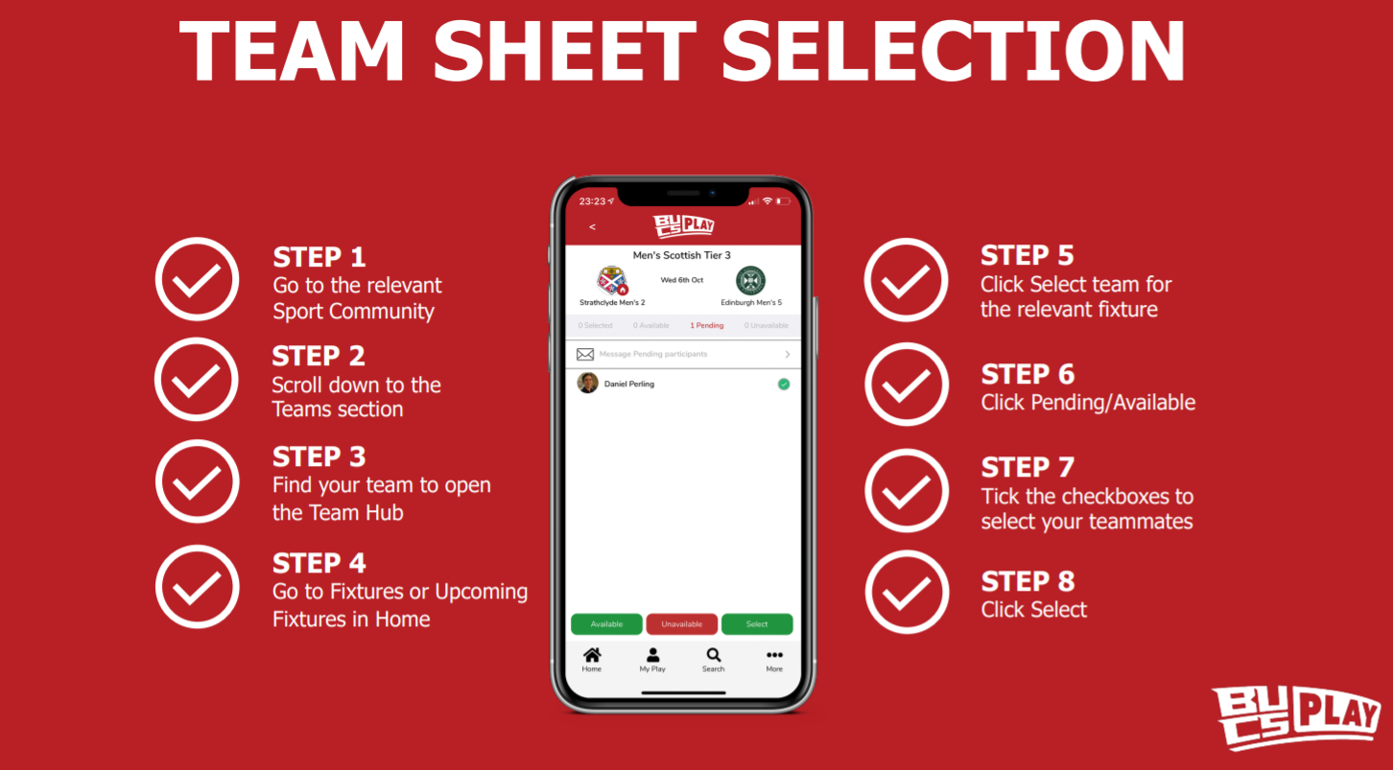

Slide 22
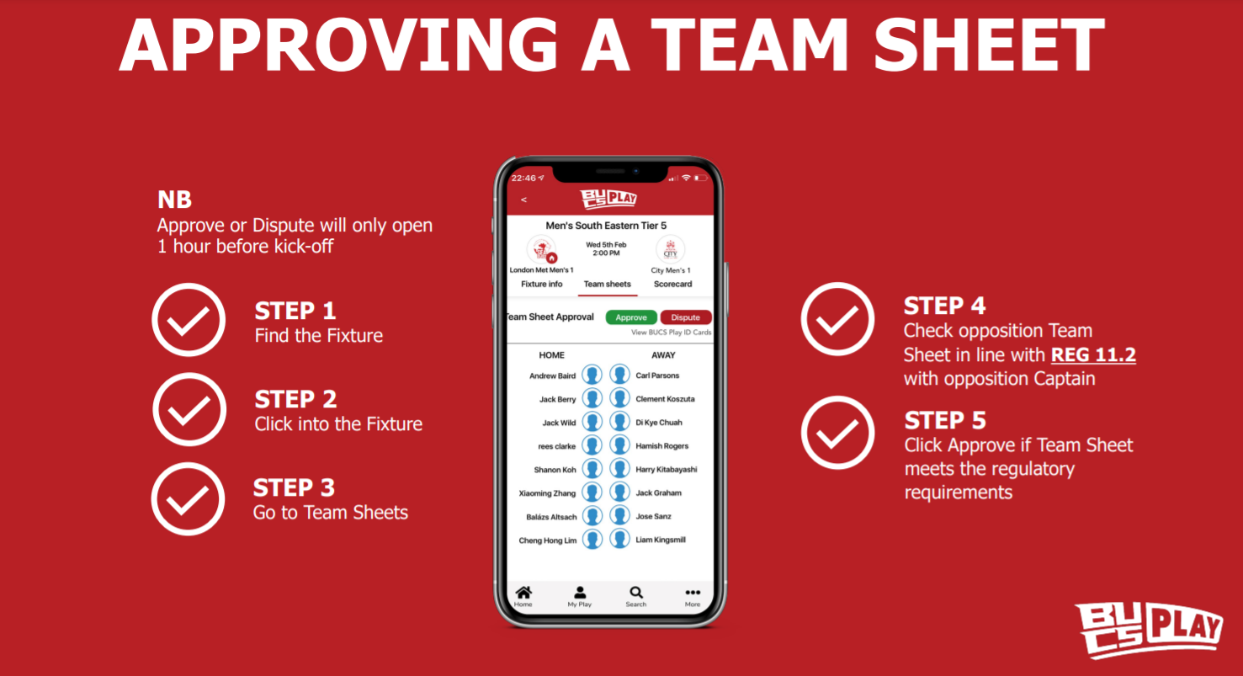

Slide 23
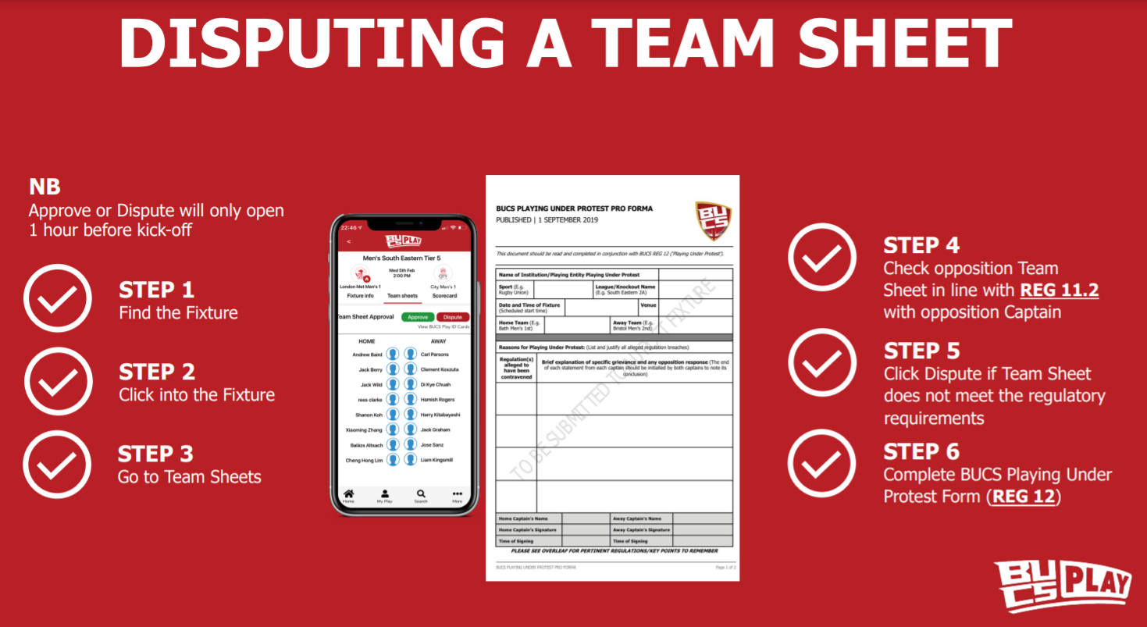

Slide 24
Captain's responsibilities to be completed IMMEDIATELY AFTER ALL FIXTURES!
1. Entering match scores
24
Notes:
Speaker: Ny

Slide 25
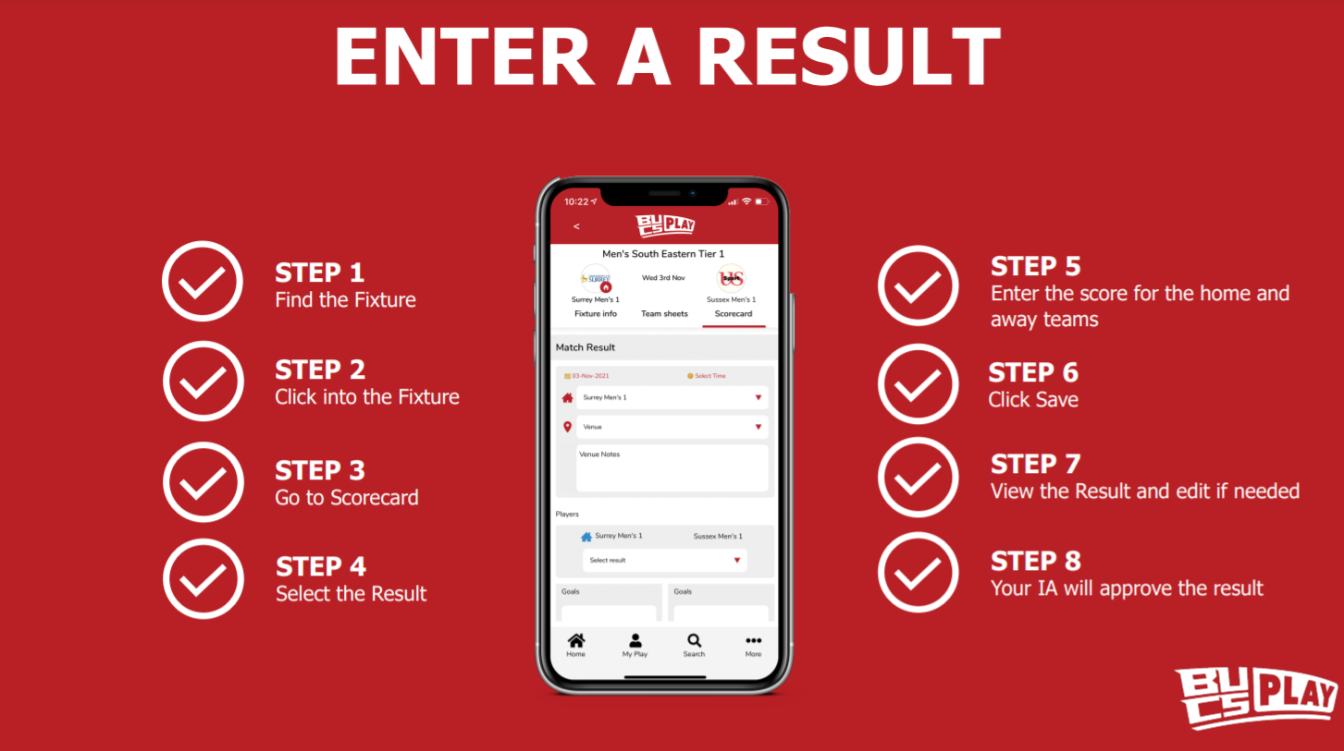

Slide 26
How to view your fixtures, knockouts and league tables:
26
Notes:
Speaker: Ny

Slide 27
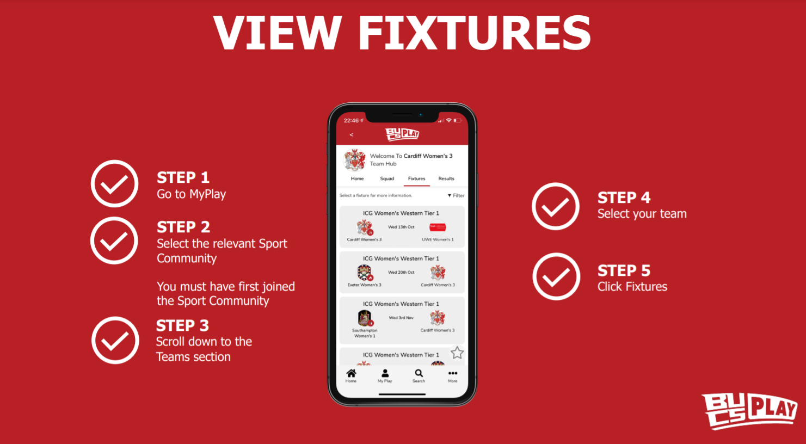

Slide 28
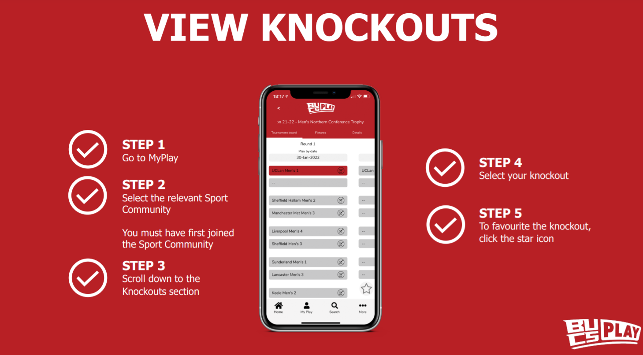

Slide 29
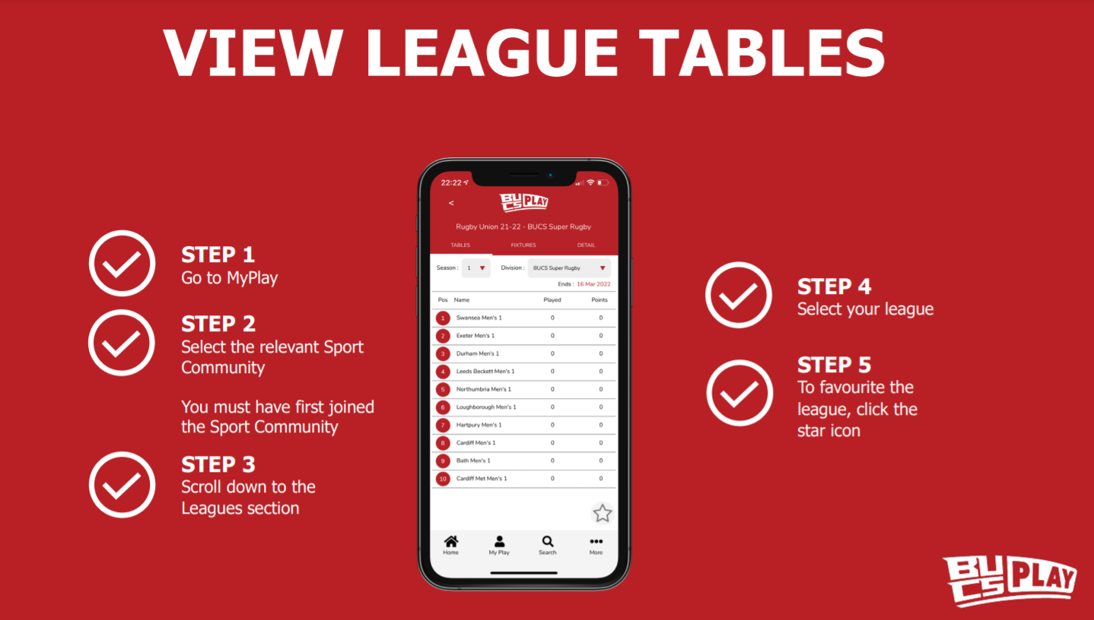

Slide 30
Captains Responsibilities
arts-su.com

Slide 31
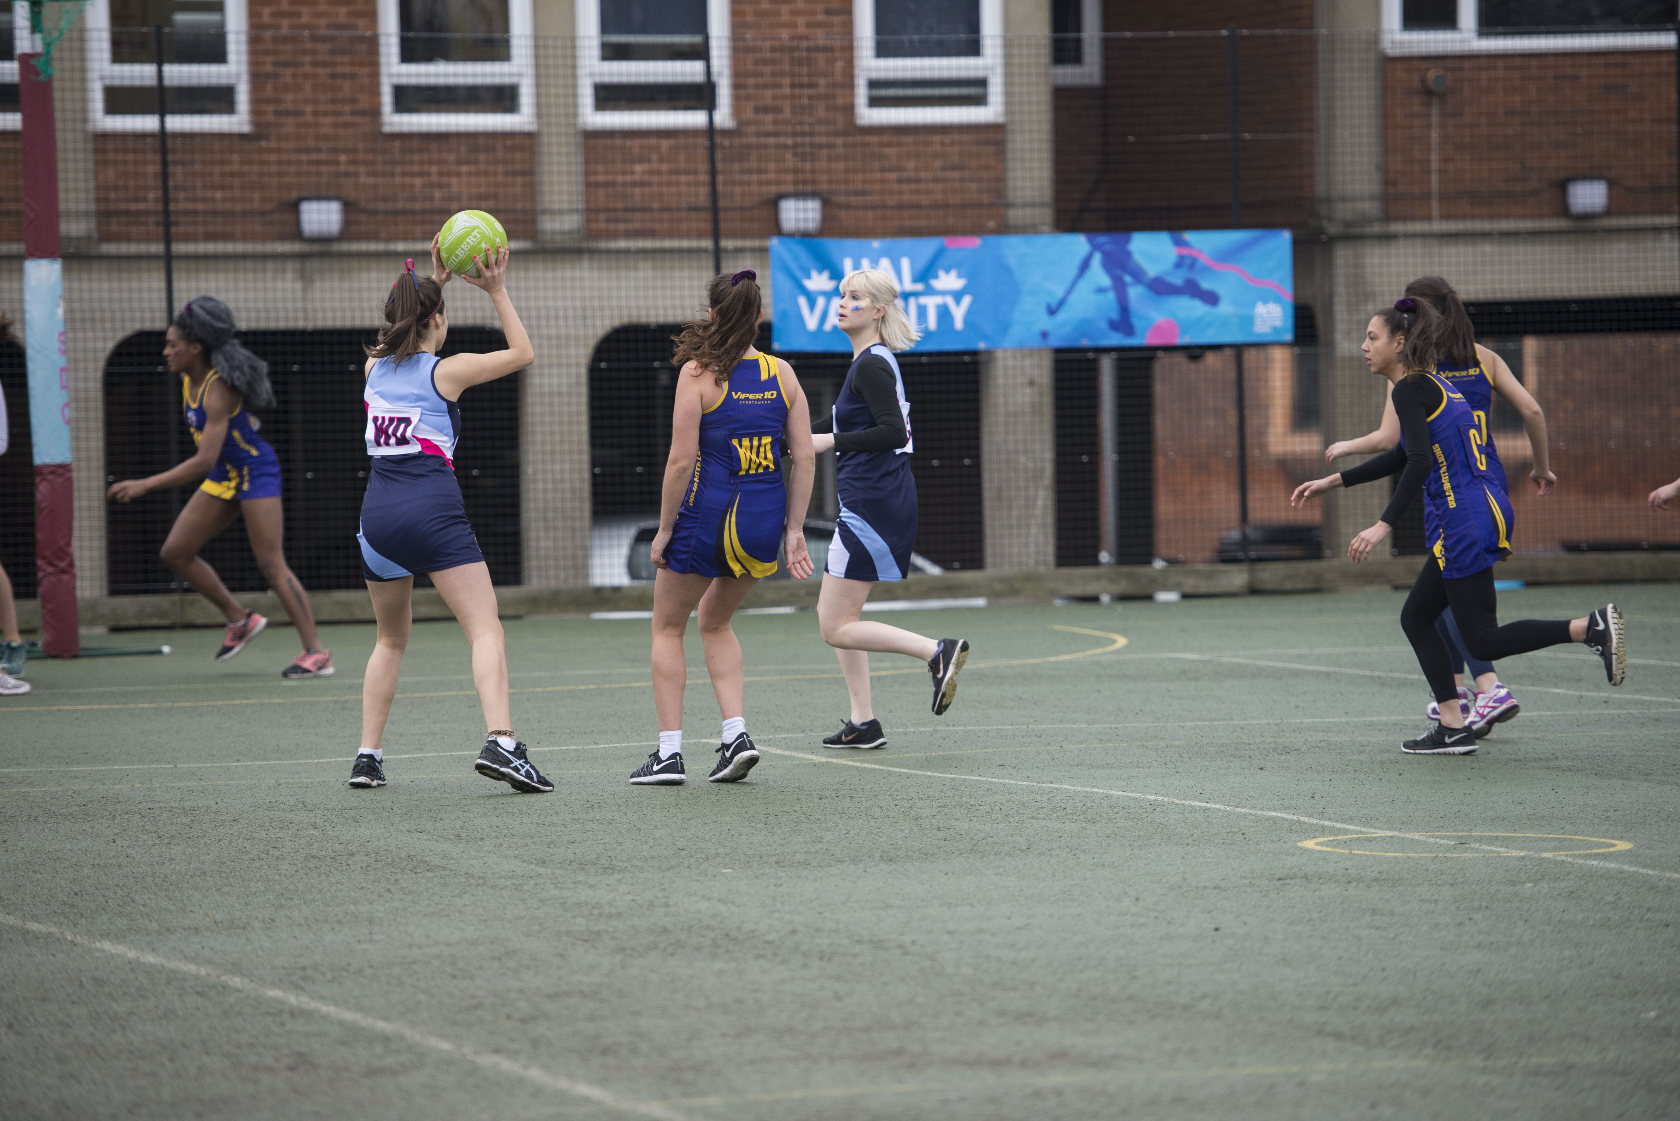
Before your fixture
Check your emails!
Arrange your transport (with the SU)
Communicate the necessary information to your players
Make sure the kit is washed and packed
Pack the equipment
Pack x2 paper Team Sheets and x2 Playing Under Protest forms
Remind players to bring their student ID cards

Slide 32
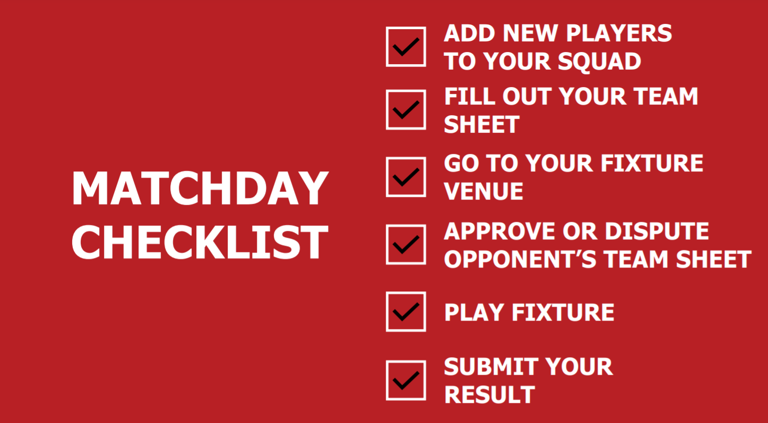

Slide 33
Your BUCS Week
Thursday | Receive fixture confirmation email confirming start times, venue, transport, officials, kit colours Check details and confirm with your team
Monday | Let Cecie (Institution Administrator) know of any problems by 12pm noon latest Select squad on BUCS Play
Tuesday | Double check fixture on BUCS Play Check emails in case of any last-minute changes/cancellations
Wednesday Game Day! | Remember: Team sheets, Playing under Protest forms, Student ID cards, equipment, kit Arrive at venue in good time Complete team sheet and approve/dispute opposition's team sheet on BUCS Play Input results on BUCS Play immediately after the game
Thursday | Report any accidents, injuries or disputes from the previous day to Cecie Wash kit

Slide 34
Your LUSL Week
Tuesday | Receive fixture confirmation email confirming start times, venue, transport, officials, kit colours Check details and confirm with your team
Thursday | Let Cecie (Institution Administrator) know of any problems by 12pm noon latest Select squad on BUCS Play
Friday | Double check fixture on BUCS Play Check emails in case of any last-minute changes/cancellations
Saturday/ Sunday/Monday Game Day! | Remember: Team sheets, Playing under Protest forms, Student ID cards, equipment, kit Arrive at venue in good time Complete team sheet and approve/dispute the opposition's team sheet BUCS Play Input results on BUCS Play immediately after the game
Following Day | Report any accidents, injuries or disputes from the previous day to Cecie Wash kit

Slide 35
Any Questions?
arts-su.com

