Slide 1
Finance Training Sports Clubs and Societies
September
FY 2023 - 2024

Slide 2
Aims
Arts SU financial procedures
Financial Year
Time-frames for submissions
Payment Request Forms and how to submit a PRF
Supplier Invoice Policy
How to submit an Invoice
Reports and Budgeting

Slide 3
Period/Year
Month / Year | Accounting System
Aug 2023 | 01/2023
Sep 2023 | 02/2023
Oct 2023 | 03/2023
Nov 2023 | 04/2023
Dec 2023 | 05/2023
Jan 2024 | 06/2023
Feb 2024 | 07/2023
Mar 2024 | 08/2023
Apr 2024 | 09/2023
May 2024 | 10/2023
Jun 2024 | 11/2023
Jul 2024 | 12/2023
Notes:
We follow the same structure as UAL

Slide 4
Why do we work by Period/Year?
To reflect an accurate financial position of your club or society
To ensure everything works by date “tax point”
Invoice/PRF must go in based on its date
Months get closed off!
Once closed we do not post to that period
If an Invoice is missed from a previous month it will appear in the next month
This will not completely reflect the accurate position of your account
Please send all incoming Invoices/PRFs by end of the month (one week grace period)

Slide 5
VAT
VAT does not apply when it comes to clubs and societies (out of scope)
The SU acts as a “bank” for each club or society meaning that any income is not the SU’s
We cannot reclaim any VAT on invoices from a club or society

Slide 6
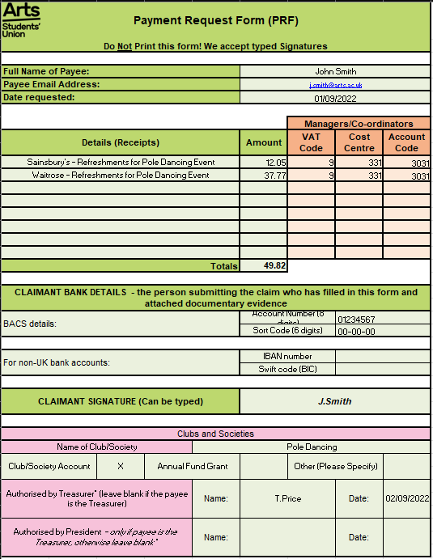
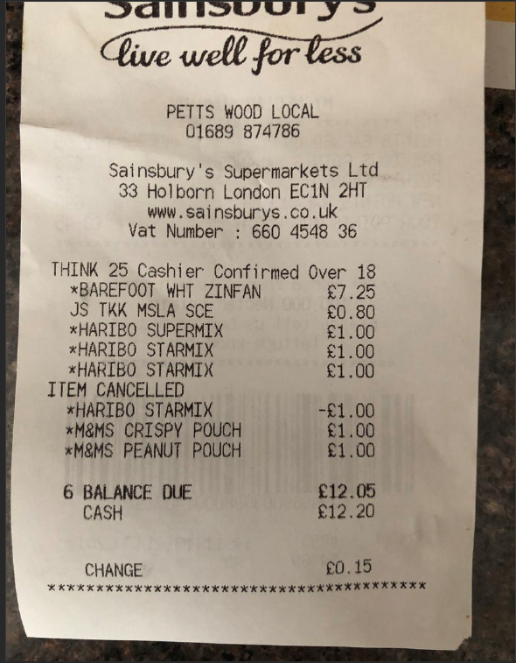
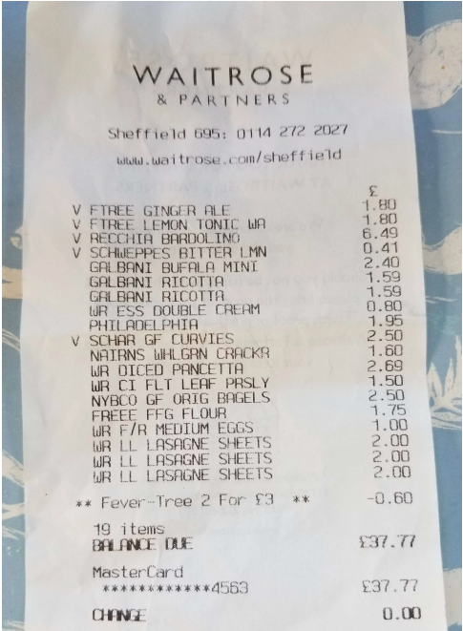
Receipt 1 – Sainsbury’s
Receipt 2 – Waitrose

Slide 7
How to submit a Payment Request Form
Agree the purchase with your treasurer prior to making it!
Step 1
Complete the Payment Request Form (PRF)
Clear description (what and why)
Each receipt on its own line – Do NOT join receipts together.
Bank details – try to use the same details
Don’t forget to sign the form
Step 2
Email your Treasurer the completed PRF with a copy of your receipt(s)
Check picture size
Label your receipts to match your PRF. It will be reviewed multiple times. Make sure that they are in a clear order to ensure it gets paid quickly
Step 3
Treasurer will check and sign the PRF and email it to their Coordinator – Niv (Societies) and Cecie (Sports Clubs)
If the Treasurer is the one who has made the purchase and completed the PRF, please send the PRF and receipt(s) to the President to sign
President will send the completed PRF back to the Treasurer to send to their Coordinator
ALL FINANCIAL DOCUMENTS MUST BE SENT FROM THE TREASURER TO THEIR COORDINATOR!
Notes:
If you change banks then please notify us on the form!

Slide 8
Ensure your PRFs and receipts are...
Clear and understandable
The PRFs must be in Excel format
Receipts are clearly labelled
Remember your bank details
Sent in the same month the purchase was made

Slide 9
If your PRF is not clear and understandable it will be sent back to you!

Slide 10
Invoice Requirements
The University of The Arts Students’ Union
272 High Holborn
London
WC1V 7EY
Follow the Supplier Invoice Policy 22-23
Correct Name and Address – this must include the Students’ Union
Invoice No.
Suppliers Name and Address
Suppliers Bank Details
Company Registration Number or Self-employed tax statement
I am registered as self-employed either in the UK with HM Revenue & Customs (HMRC), or in the country where I reside, and as such am responsible for paying my own tax and national insurance contributions.

Slide 11
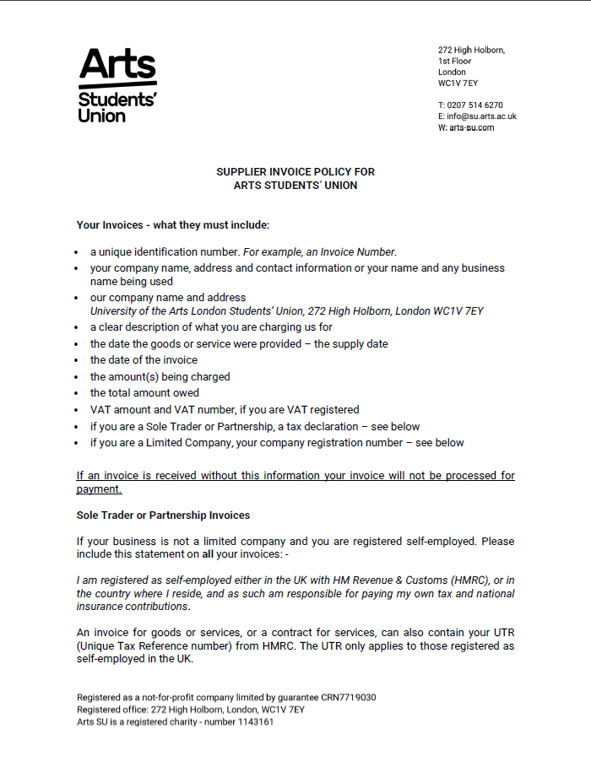
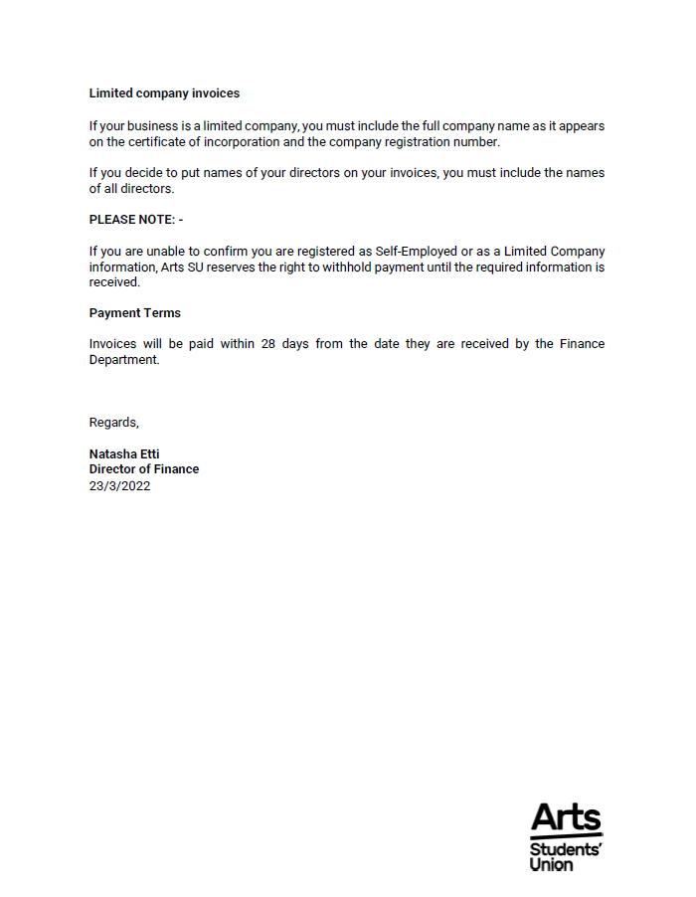

Slide 12
New Supplier Form
Link can be found on the Committee Resources Page
Please send the Supplier Invoice Policy and NSF to Supplier at when you first agree to work with them.

Slide 13
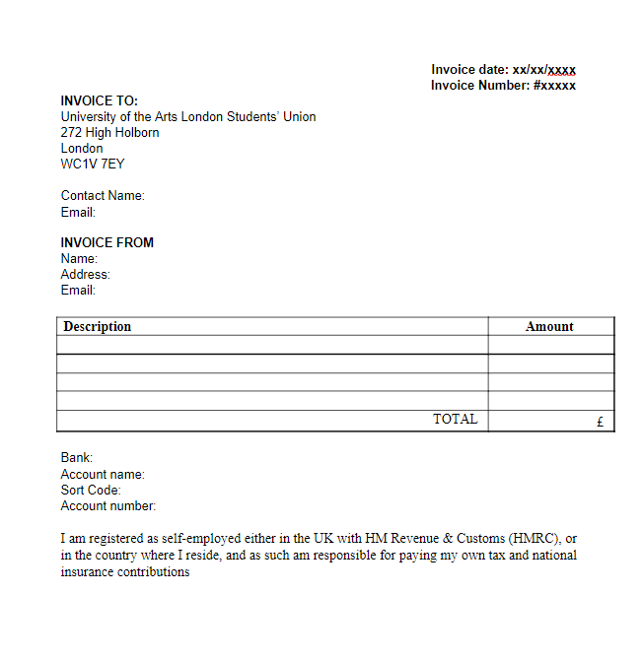
Suppliers may already have their own invoice templates, but if not, feel free to share our Invoice Template.

Slide 14
Submitting an Invoice
You receive an Invoice
Check the Invoice meets the Supplier Invoice Policy
Send it back to the supplier for amendments if you have a query or it doesn’t meet the policy standard
Review the amended Invoice
Send it to your Coordinator (Niv - Societies, Cecie – Sports Clubs) and state whether you want the money to come out of your private or grant account
Your Coordinator will review the Invoice and send it to Finance if the Invoice meets the Supplier Invoice Policy

Slide 15
Private and Grant Account
PRIVATE
Non-restricted money
GRANT
Restricted money

Slide 16
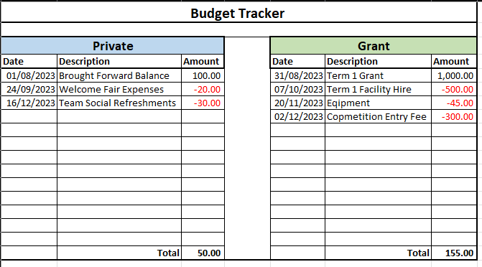
Budgeting You are responsible for keeping track of your Income and Expenses!

Slide 17
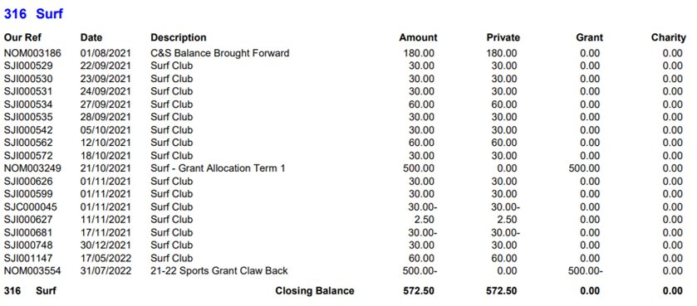
Reports

Slide 18
Important Information
All invoices and PRFs will be processed and paid within 30 days of the SU receiving the completed documentation
Any invoice that does not meet our Supplier Invoice Policy cannot be paid until updated/correct invoice is received
PRF receipts/invoices older than 3 months will NOT be accepted
Any receipt without all the correct information will not be accepted

Slide 19
Where to find the financial documents
You can find the following forms on the Committee Resources Page:
Supplier Invoice Policy 22-23
New Supplier Form
Payment Request Form 22-23 (PRF)
Invoice Template

Slide 20
Summary
Download the new PRF for 22-23 from the Committee Resources Page
Receipts and Invoices must be clear and understandable
Always follow the Supplier Invoice Policy!
Send all Invoices/PRFs within the month they are dated
Keep and check your budget tracker regularly

Slide 21
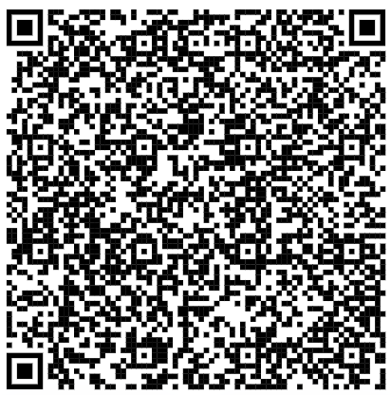
Grant Applications
Societies
Sports
LINK
LINK

Slide 22
Grant Application Dates
Sports
Please submit your grant applications before:
October 1st 2023

Slide 23
Grant Application Dates
Societies
October 18th 2023
November 15th 2023
December 6th 2023
February 21st 2024
March 13th 2024
April 17th 2024
May 22nd 2024

Slide 24
Thank you!

