Slide 1
Society Grants 2023/24

Slide 2
What are the grants for?
Each year Arts SU receives a block grant from the University to support student activities and a proportion of this is made available to societies through an application process.
The purpose of the funding is to support societies to run activities, projects, events, or initiatives to further their aims and objectives.
You can submit a grant request for either:
Your society’s regular activities e.g. a series of workshops, meet ups, classes, tutor fees etc
One off activities e.g. an exhibition, a one off workshop, a fashion show etc
2
Notes:
Speaker: Ny

Slide 3
How do we apply?
You must fill in a:
Society Grant Request form
AND a Grant Budget Template
These can be downloaded from the Committee Resources Page
You must show how your activity fits within your society’s aims/objectives
These should have been rewritten and signed when you submitted your society development pack this year.
Your activity must benefit as many society members as possible
Please read the full Society Grant Application Guide for all rules and regulations around the society grants.
3
Notes:
Speaker: Ny

Slide 4
Grant Deadlines
October 1st 2023
October 18th 2023
November 15th 2023
December 6th 2023
February 21st 2024
March 13th 2024
April 17th 2024
May 22nd 2024
Send all applications to Niv at societies@su.arts.ac.uk
4
Notes:
Speaker: Ny

Slide 5
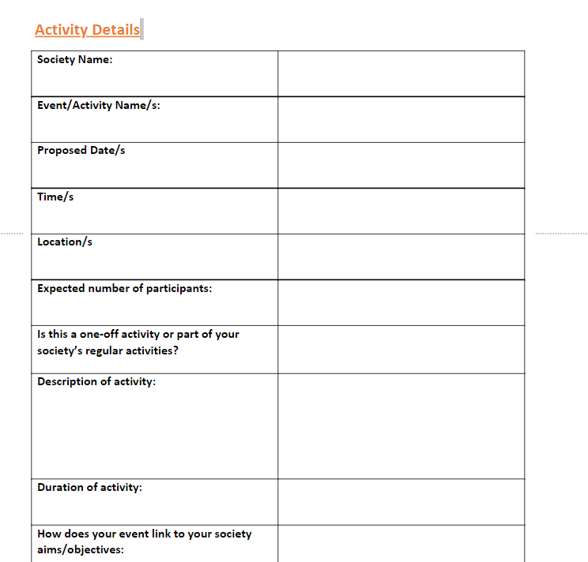
Grant Application Form 1
The first part of the grant application form asks for basic details of your activity/s
If you are applying for a grant for a series of activities just include details of these and approximate dates.
5
Notes:
Speaker: Ny

Slide 6
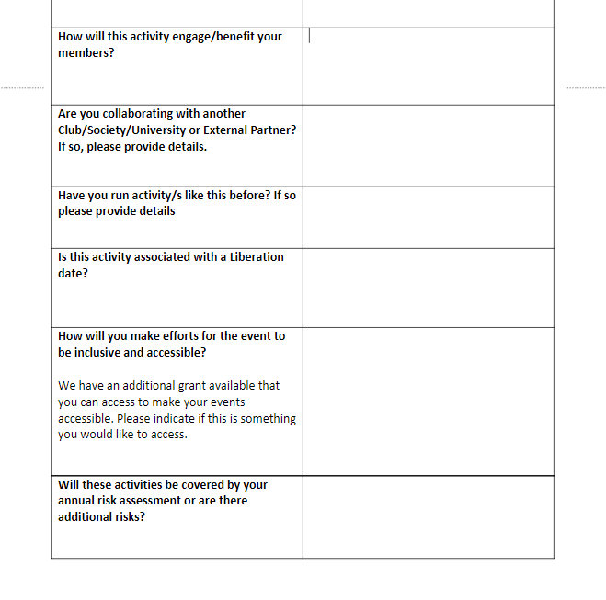
Grant Application Form
The second section requests more details about your activity including whether:
You are collaborating with an external partner
Your activity is associated with a liberation date
You have thought about inclusivity and accessibility
Whether it will be covered by your annual risk assessment
6
Notes:
Speaker: Ny

Slide 7
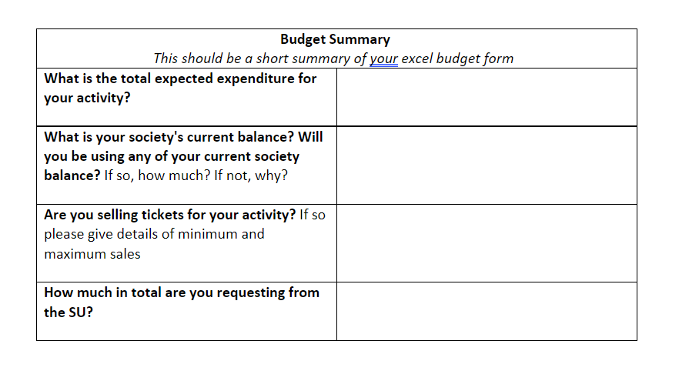
Budget Summary on Grant Form
The next part of the form asks you for your ‘Budget Summary’
This can only be completed, after you can fill in your Grant Budget Form on Excel
So your next step is to download the Excel document.
7
Notes:
Speaker: Ny

Slide 8
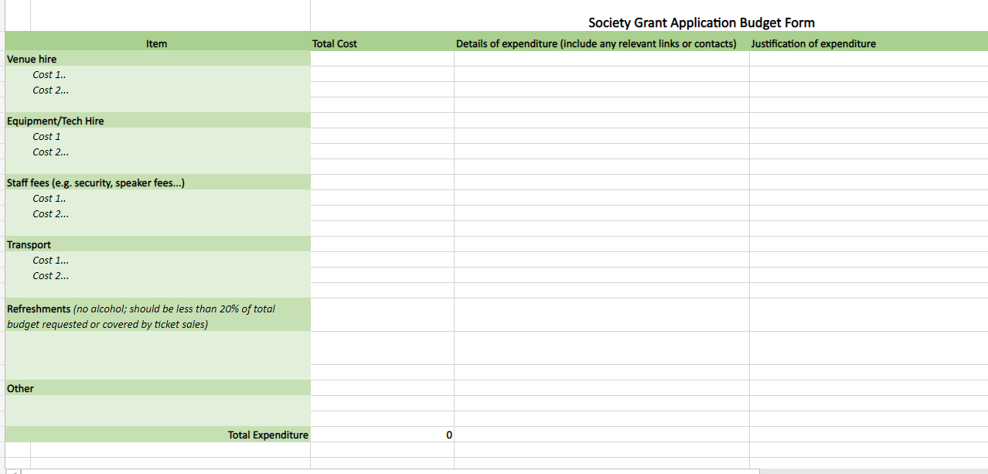
Excel Grant Budget Form: Spending
Be detailed and specific, outline exactly what you want.
Use one line per spending and add as many lines as you need.
Link it to your aims and objectives – demonstrate how this money will help you meet your targets for the year. This doesn’t need to be complicated.
Include links/your research into your costings – show that you’ve done everything you can to get the best deal possible. You can include reference to previous spending if you have run an activity like this before.
Your total should be automatically calculated by the excel document
8
Notes:
Speaker: Ny

Slide 9
Excel Grant Budget Form: Income
If your society will be using some of your private/membership money please include this here.
Please include details of the ticket sales you need to make to fund your activity.
Your total should be automatically calculated by the excel document
Please include any information that might be relevant e.g. what maximum and minimum ticket sales do you need to make. Is the ‘other income’ secured or provisional?
Don’t forget to include any ‘other income’ e.g. contributions from any collaborating SU’s or sponsorship money
9
Notes:
Speaker: Ny

Slide 10
Budget Summary on Grant Form
Once you have filled in your Excel sheet, you can use the figures on the sheet to fill in your Budget Summary on the Grant Document.
10
Notes:
Speaker: Ny

Slide 11
Submitting your Grant Proposal
All grant applications should be submitted to societies@su.arts.ac.uk
Make sure you attach both your written Society Grant Application Form AND Society Grant Application Budget (excel) together.
You can apply for grants as far in advance as you would like.
E.g. you can submit an application for a series of activities in Term 2 in Term 1.
Proposals for larger grants/activities should be submitted to the panel at least one month in advance of the event.
The President of the society, if not submitting the application MUST be cc’d in the email submission.
If there are a large volume of application, we may consider including an additional panel.
11
Notes:
Speaker: Ny

Slide 12
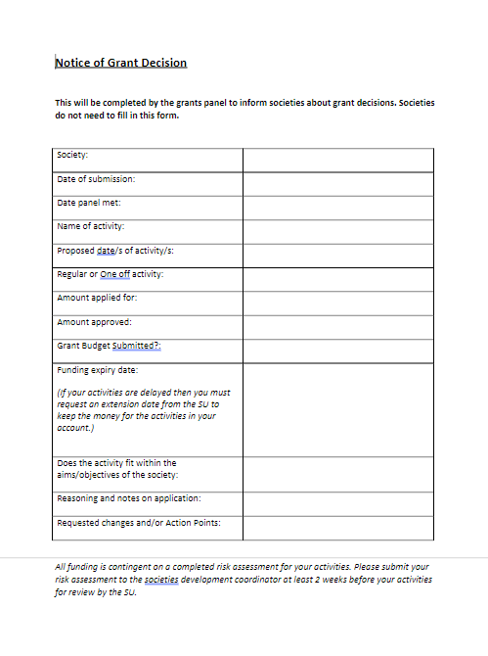
How long do we have to spend the money?
A panel will meet the second Wednesday of every month to discuss applications and distribute grants.
Make sure that you complete your submission the week before the panel meets to ensure it is considered in that round of applications.
Late applications will be discussed the following month.
The dates for Term 1 are as follows:
28th September (next week)
19th October
16th November
7th December
12
Notes:
Speaker: Aylin

Slide 13
How long do we have to spend the money?
After the panel has met they will email you a ‘Notice of Grant Decision’
This will detail:
How much grant has been awarded
Funding expiry date
Any reasoning and notes on your application
Any requested changes or action points
Your grant will then be distributed to your society ‘Grant Account’ and can be accessed by PRF or Invoice.
If you would like to appeal the panel’s decision, there are instructions of how to do so on the Grant Application Guide on the Committee Resources.
13
Notes:
Speaker: Aylin

Slide 14
What can’t be funded?
We understand that written applications are not everyone’s preferred mode of communication. Therefore we also accept applications in the following formats:
Video
Presentation
Audio
Multimedia
If submitting your request in a different format, please cover as much of the information in the grant form as possible.
14
Notes:
Speaker: Ny

Slide 15
How much money can we bid for?
You can apply for up to £1000 at a time/per term, but you must provide details of what you plan to spend the money on.
On special circumstances we may consider a grant of over £1000 but you must provide justification for why it is required.
15
Notes:
Speaker: Aylin

Slide 16
What can’t be funded?
You cannot spend grant money on charity/fundraising events. No society or grant money can be spent directly on other charities because it would conflict with Charity Law. If you want to raise money for charity, you must attend the fundraising training.
Affiliation fees or donations to political bodies/charities
Committee or member merchandise
Full details of what can and cannot be funded are on the Grant Application Guidelines.
16
Notes:
Speaker: Ny

Slide 17
Rules around Food
Generally refreshments should not be over £40 per activity unless it’s an exceptional circumstance
Other refreshments should be covered by ticket prices
An exception to this is food and drink that is a core part to your society and it links to your core objectives e.g.
Baking Society wanting ingredients for a special event
Cultural Society providing specific food linked to their groups aims.
Faith Society providing food for fellowship.
17
Notes:
Speaker: Aylin

Slide 18
Rules around Alcohol
Alcohol may not be inclusive of all your society members.
If you would like alcohol at your events, this should be funded by ticket prices or purchased by individuals at the event.
Due to licensing laws, if your event is on a UAL campus you cannot advertise that alcohol is included in a ticket. You can only refer to it as ‘refreshments’
There are extra Health & Safety considerations for having alcohol at events so please discuss these with your coordinator prior to organising.
Generally refreshments should not form more than 20% of grant application.
18
Notes:
Speaker: Aylin

Slide 19
Why does our grant expire?
If you do not use the money by a certain date, this will be returned to the SU so that other societies can bid for it.
This date will be set in your grant approval and will be based on the proposed date of your activities
You must communicate with the SU if you would like to request an extension or if you will not being using your grant money. This is so it can be reallocated to other societies.
All grant funding across the Students’ Union needs to be spent by the final day of the academic year.
19
Notes:
Speaker: Aylin

Slide 20
Any Questions?

